Slide 1
ROOFTOP SOLAR PV POWER PROJECT
GHEIPL-NRR Solar JV.

Slide 2
Index:
ABOUT US
SERVICES OFFERED
SUCCESSFUL INSTALLATIONS
AREAS OF COMPLETED/ONGOING WORKS
CLIENT LIST
GRID-CONNECTED SPV ROOFTOP SYSTEMS
ADVANTAGES OF SOLAR POWER
USEFULNESS OF SOLAR ROOF TOP
PROSPECTS OF SOLAR ROOF TOPS
5 KW SOLAR ROOF TOP PROPOSAL

Slide 3
About Us……..
Greyhound Engineers India Pvt Ltd. is an established company in steel space for the last 15 years . It has executed steel works projects in various states in India as well as in foreign countries like Afghanistan &P.R.of Congo for various public and private sector clients. It is also actively pursuing opportunities in solar and renewable space.
Large number of solar projects( Rooftop/Solar Park) have been successfully executed by us and we are also providing O&M services to our prestigious clients.

Slide 4
Services offered :-
Customized Solar Solutions
EPC and I&C of Solar Power Systems
Operation & Maintenance of Solar Power Systems
DPR preparation of Solar Power Projects
Pre-feasibility Preparation of Solar Power Projects
Project Consultation.
“All under one Roof ”

Slide 5
Areas of completed/ongoing works
INDIA
Himachal Pradesh,
Uttarakhand
Jammu & Kashmir,
Uttarpradesh
Madhya Pradesh
Jharkhand etc…
AFGANISTAN
AFRICA- CONGO

Slide 6
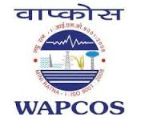
Client List
L&T
VA TECH
ANGELIQUE INTERNATIONAL
JAY PEE ASSOCIATES
LANCO INFRATECH
SSJV (For NTPC Project)
SSNNL (Sardar Sarovar Narmada Nigam Limited, Gujarat.)
NHPC (National Hydro-Electric power Corporation Ltd.)
SJVNL (Satlaj Jal Vidyut Nigam Ltd.)
STATE IRRIGATION DEPARTMENT, Uttar Pradesh
WAPCOS etc..

Slide 7
Advantages of Solar Power……
CLEAN POWER
Solar energy is environment friendly. When in use, it does not release CO2 and other gases which pollute the air. Hence it is very suitable for India, India being one of the most polluted countries of the world.
FREE
This is an inexhaustible source of energy and the best replacement to other non-renewable energies in India.
IDEAL SOURCE OF ELECTRICITY IN REMOTE PLACES
Solar energy can be used for variety of purposes like as heating, drying, cooking or electricity and is suitable for the remote and rural areas.
CHEAP
In an energy deficient country like India, solar energy is the best alternate means of power generation. A solar energy system can be installed anywhere. It is quite inexpensive compared to other sources of energy in the long run.

Slide 8
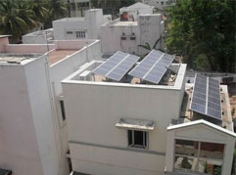
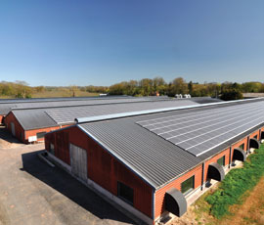
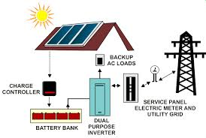
Usefulness of Solar Roof top
Shall Reduce the carbon footprint in an environmentally sensitive areas
Can be the ideal source of energy for remote areas
Surplus energy from other sources could be sold in the market earning precious revenue
Shall also result in generation of employment for people in remote areas

Slide 9
THANK YOU

